Slide 1
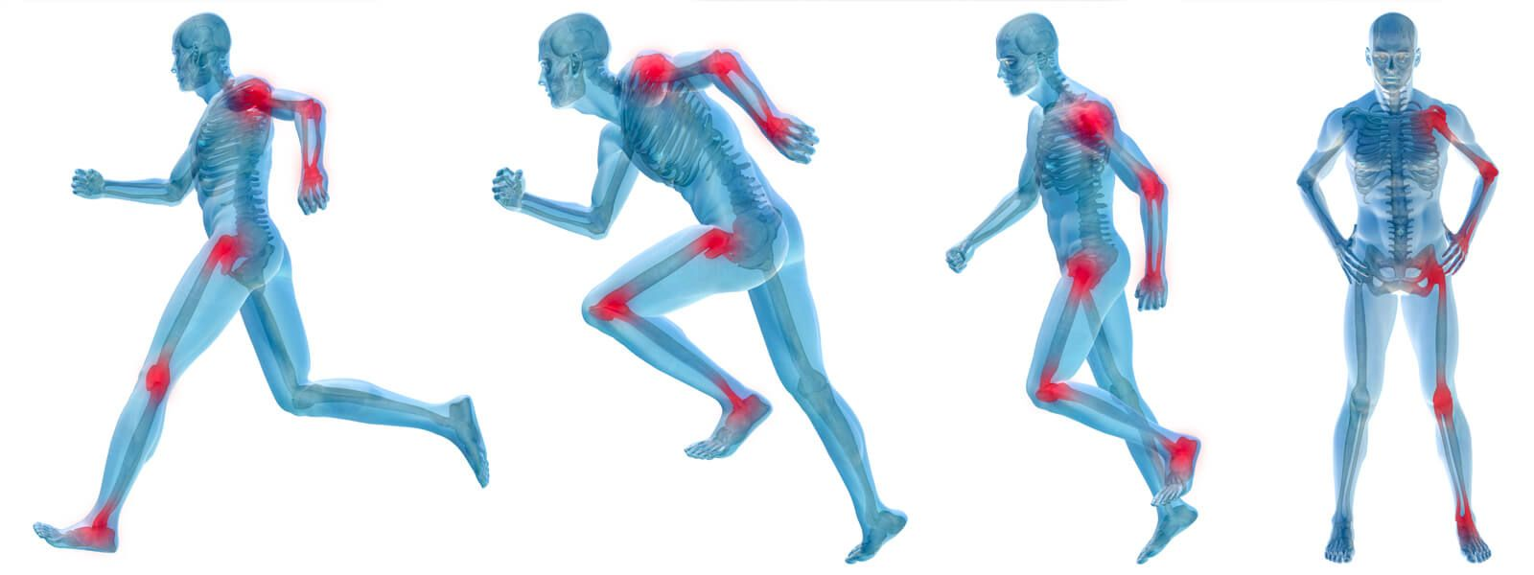
Sports Injury Prediction Predictive Analytics Project – D7056E Group 3: Athanasios Koutoulas Bruno Reis Da Silva Isabella Södergren Venkata Sreenadh Movva

Slide 2

What is Injury Prediction?
Injuries common in sports
Negative impact on athletes, teams, coaches sports organizations
Imperative to tackle the problem!
Process of building predictive models and integrating them to sports culture
Tasks:
injury prediction
body parts likely to be injured
severity prediction
suggest resting days after injury

Slide 3
Business Problem
Negative Impact on organization’s revenue
Cover operation and treatment costs
Dedicate extra resources - doctors, physiotherapists, special trainers etc.
Purchase equipment to ensure smooth recovery
Salary payment during player’s injury
Negative impact on a future transfer profit
Player’s popularity in the market drops -> Negative impact on jersey selling
Negative impact on team’s win-loss record -> Negative impact on ticket, subscription selling
Injuries in high frequency -> Concern for future player transfers

Slide 4
Potential Analytical Solutions Solution 1
Injury prediction models based on metrics from wearable technology
Minimize injury risk, improve training quality
Collect data from wearable devices during practices
- bodysuits, vests, wristbands, GPS devices
Historical data from sensor metrics
- running distance, speeds, accelerations, decelerations, body part reaction times, heart rates, body temperatures, respiration rates, quality of sleep
Insights on players
- workload intensity, physical condition, body core weaknesses
Predict injury, severity, body parts based on combinations of metric values

Slide 5
Potential Analytical Solutions Solution 2
Injury prediction models based on historical injury data
Understand uncorrelated factors, improve team formation
Collect injury data from previous games
- body part, injury/recovery duration
Collect game data
- stadium type, field type, weather, temperature
Collect player data
- number of games, participation time, roster position, game position, play type
Predict injury, body parts, suggest resting days based on past occurrences

Slide 6
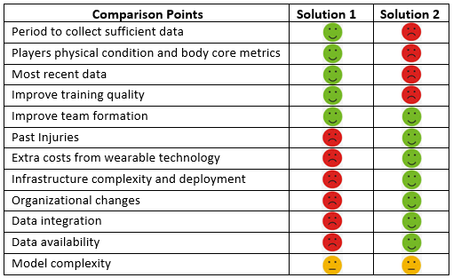
Potential Analytical Solutions Solution Comparison
Injury rates are about 2.7 times higher in competition compared to practice
https://training-conditioning.com/article/injury-rates-for-practice-vs-competition/

Slide 7
Selected Solution Solution 1: Injury prediction models based on historical injury data
Focus on US NFL injury prediction
Datasets:
Play List: information on players and game specifics
- Indexed Playerkey, GameID
Injury Record: information on injuries over two seasons
- Linked to Playerkey, GameID
Approach problem with 3 predictive tasks:
1) Injury prediction
binary classification
Insight validity: between previous and next game
2) body parts likely to be injured
multi-class classification
Insight validity: between previous and next game
3) suggest resting days after injury
- continuous
- Insight validity: from injury until end of resting period
Dataset source: https://www.kaggle.com/c/nfl-playing-surface-analytics/data

Slide 8
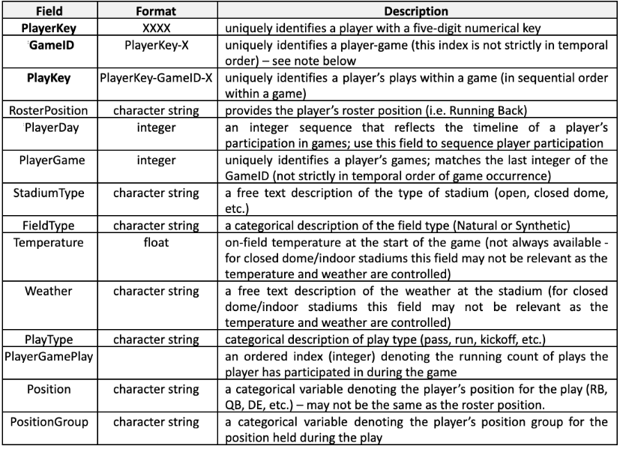
Dataset Description Play List

Slide 9
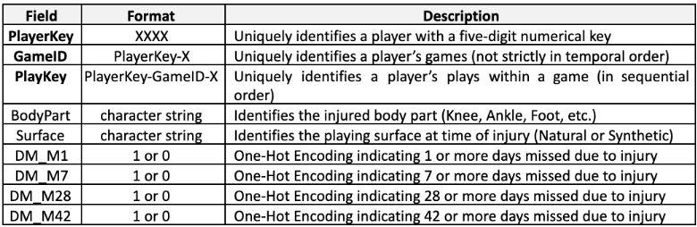
Dataset Description Injury Record

Slide 10
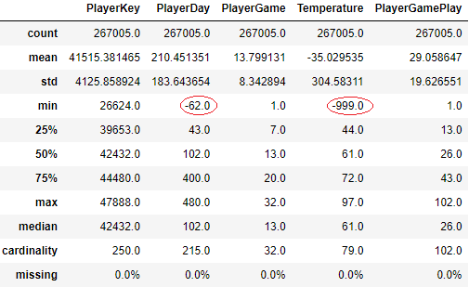
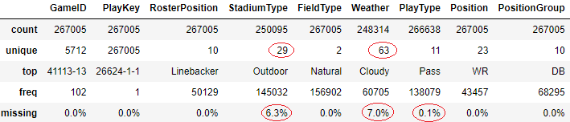
Data Understanding & Preparation PlayList dataset
Continuous features ABT Categorical features ABT
- Replace missing values with mode
- Normalize features with high cardinality
Weather: Rain, Rainy, Light rain -> Rainy
Stadium Type: Indoor, Indoors, Closed -> Indoors
- 9% of temperatures replaced with median
- Negative PlayerDay replaced with abs value
- No outliers after replacements
- Remove duplicated rows

Slide 11
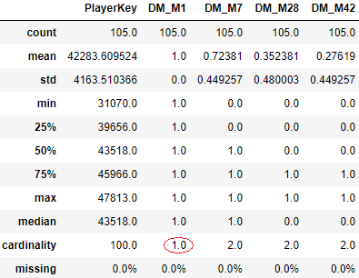
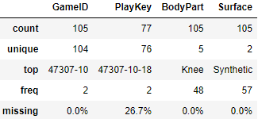
Data Understanding & Preparation Injury dataset
Continuous features ABT Categorical features ABT
- No issues
- Drop columns with repetitive info (Surface)
No duplicates
No outliers
Drop feature with cardinality 1

Slide 12
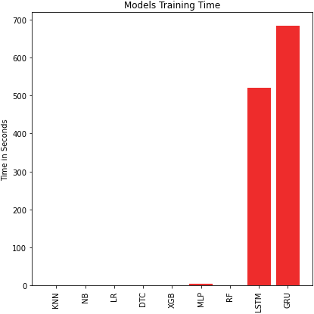
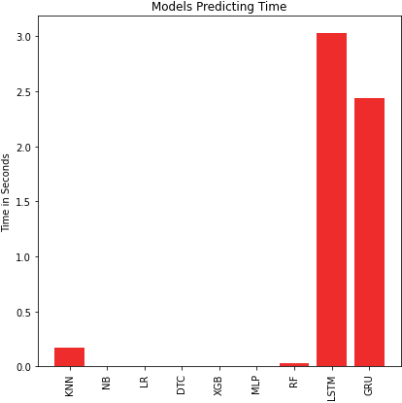
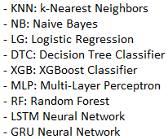
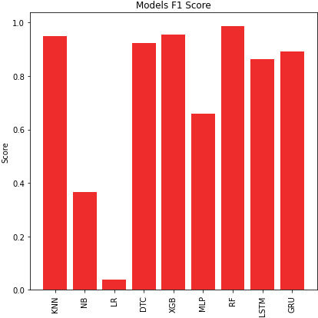
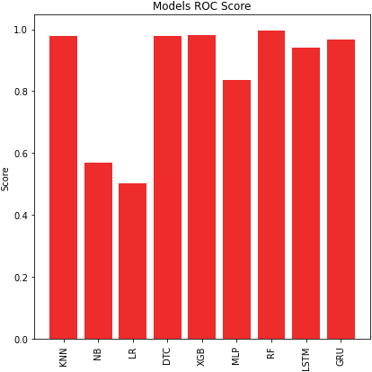
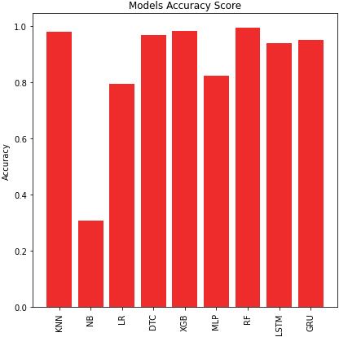
Modeling Phase Task 1: Predict Injury
Dataset
Merge datasets on GameID
5712 data points, 105 injuries
Merge Injury features
- DM_M1, DM_M7, DM_M28, DM_M42 -> Injury {0, 1}
One-hot encode categorical features
- Weather -> weather_Rainy, weather_Snowy etc.
59 descriptive features
Target feature
0: no injury, 1: injury
Oversampling 1:4 ratio - 7010 rows
0: 5608
1: 1402
Train – Test dataset:
Algorithmic models 80-20
Neural Networks 70-30

Slide 13
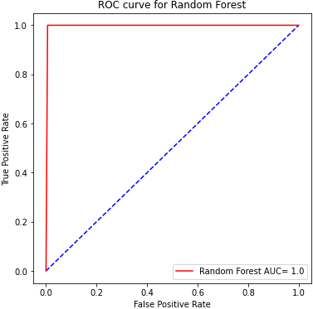
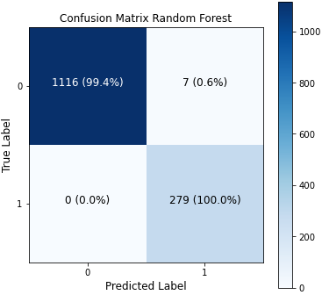
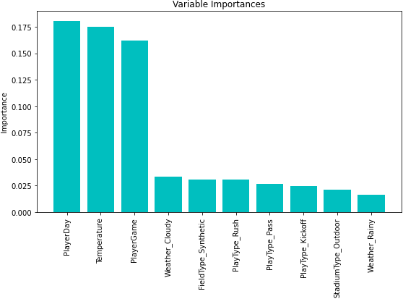
Modeling Phase Task 1: Best Model
Random Forest
Individual decision trees for each sample
Individual trees generate output
Majority voting for final output
Source: sklearn
Parameters
n_estimators: 128
n_jobs: 8
max_features: auto
criterion: Gini
No max_depth

Slide 14
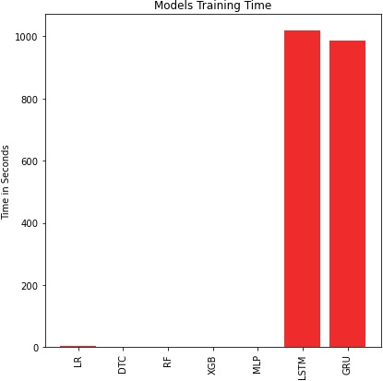
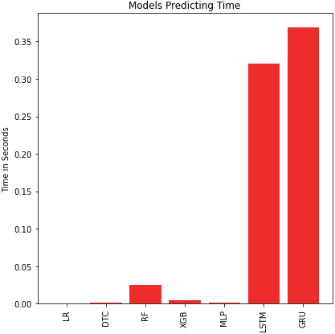
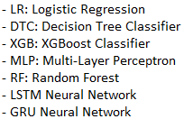
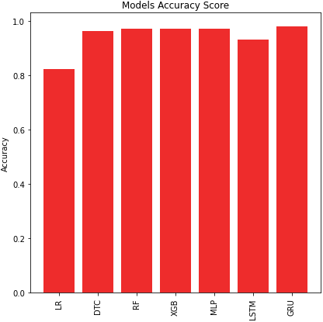
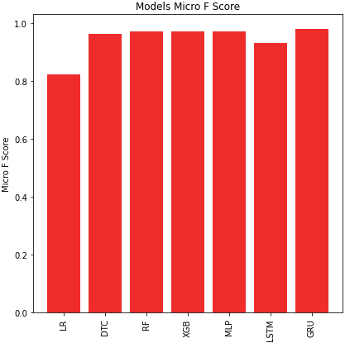
Modeling Phase Task 2: Predict Body Part
Dataset
Merge datasets on GameID
5712 data points, 105 injuries
Use only the injured cases
One-hot encode categorical features
Filedtype -> Fieldtype_Natural, Fieldtype_Synthetic etc.
55 descriptive features
Target feature:
Body part
One-hot encoding for NNs
Oversampling x10 – 1050 rows
Ankle: 420, Foot:70, Heel: 10,
Knee: 480, Toes: 70
Train – Test dataset:
Algorithmic models 80-20
Neural Networks 70-30

Slide 15
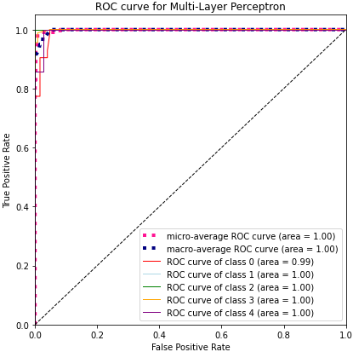
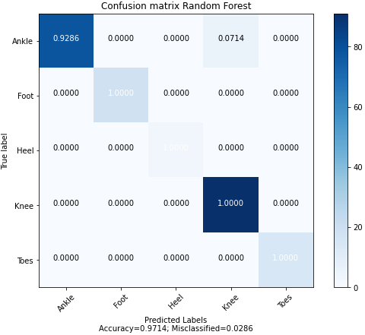
Modeling Phase Task 2: Best Model
Multi-Layer Perceptron
Fully connected NN
Feedforward
Layers: input, hidden, output
Source: sklearn
Parameters
hidden_layer_sizes: 1 layer, 100 neurons
activation: relu
solver: adam
learning_rate: constant
alpha (L2): 0.0001

Slide 16
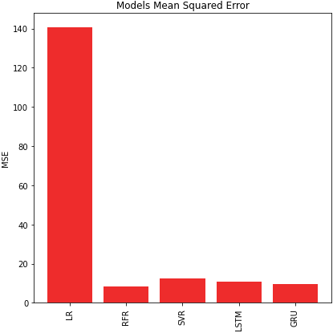

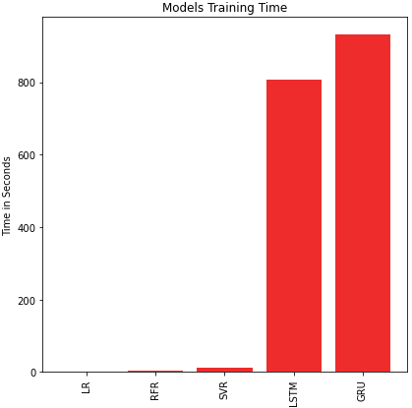
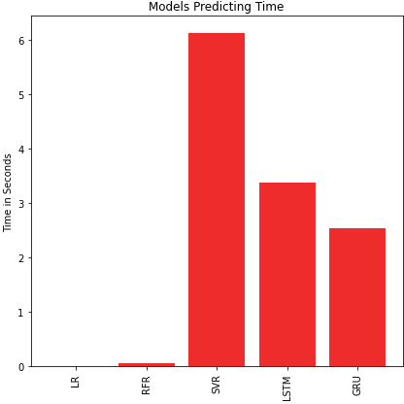
Modeling Phase Task 3: Predict Resting Days
Dataset
Merge datasets on GameID
5712 data points, 105 injuries
Use only the injured cases
One-hot encode categorical features
Field_type -> Fieldtype_Natural, Fieldtype_Synthetic etc.
51 descriptive features
Target feature:
Resting days
Oversampling x100 – 10500 rows
1-6: 2900, 7-14: 3900, 15-28: 800, 19-42: 2900
Generate days within intervals
Train – Test dataset:
Algorithmic models 80-20
Neural Networks 70-30

Slide 17
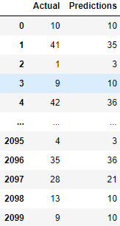
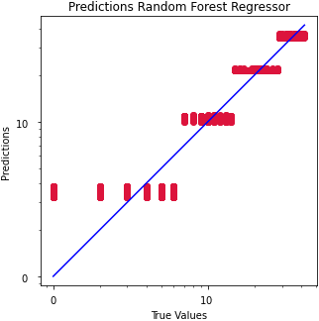
Modeling Phase Task 3: Best Model
Random Forest Regressor
Individual decision trees for each sample
Individual trees generate output
Mean for final output
Source: sklearn
Parameters
n_estimators: 100
max_depth: 20
criterion: squared_error

Slide 18
Deployment & Utilization
Part of internal application
Interaction through User Intrface
Task 1 & 2:
- Select next game specifics & player list
- Result: player, body part to be injured
Task 3:
- Select occured injury specifics
Result: number of resting days
Challenges:
Data-driven decision-making process
Extra costs from model utilization
- Data collection, storage, infrastructre

Slide 19
Thank you for your attention!
Questions?

